Slide 1






EVALUATION OF CUSTOMER SPENDING ON FOOD PRODUCTS USING MACHINE LEARNING
BY STUDENT NAME

Slide 2
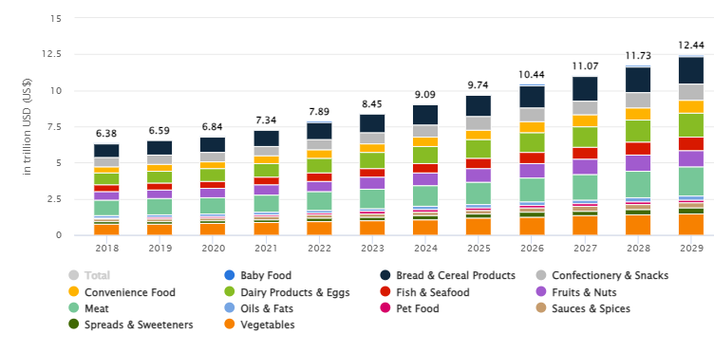
PROJECT OVERVIEW
Revenue in the retail food market has reached $9.09 trillion in 2024 and it is expected to grow by 6.48% CAGR (Statista, 2024).
This project aims to evaluate customer spending patterns on food products using Machine Learning (ML) techniques.
Through leveraging Machine Learning (Classification and Clustering technique), the project intends to uncover underlying patterns, customer segments and regional preferences of products.
Figure 1: Revenue in the retail food market
(Source: Statista, 2024)
Notes:
In this presentation, I have discussed the project overview which includes the background context of retail food markets and the need for evaluating customer spending on food products. The retail food sales worldwide reached $9.09 trillion, showing significant food consumption. Thereby, understanding customer spending patterns on food products can be helpful for businesses to capture trends in the retail food market, which can allow businesses to optimise inventory as well as marketing strategies. The main purpose of this project is to evaluate customer spending on food products by leveraging ML algorithms.

Slide 3
PROJECT PLAN - A TIMELINE WITH DATES
Week | Task | Description | Deliverables
1 | Project Setup and Understanding | - Define project goals and scope. | - Project timeline and novelty
 |  | - Development of aim and objectives | - Approval of aim and objectives
 |  | - Project proposal | - Initial data exploration report
 |  | - Review and explore the dataset for initial understanding.
2 | Data Collection and Loading | - Load the dataset. | - Clean and well-documented dataset.
 |  | - Verify data integrity and check for missing values. | - Summary statistics.
 |  | - Document data types and units of each variable. | - Visualisations
 |  | - Conduct exploratory data analysis (EDA).
3 | Data Preprocessing | - Handle any missing or outlier values | - Pre-processed dataset.
 |  | - Normalise/scale numerical features. | - Normalised/scaled features.
 |  | - Convert categorical features | - Training and testing datasets ready.
 |  | - Split the dataset into training and testing sets
4 | Feature Engineering and Selection | - Identify important features using techniques like correlation analysis | - Final list of selected features.
 |  | - Perform feature selection to remove irrelevant or redundant features. | - Feature engineering report.
5 | Model Selection | - Research potential classification algorithms | - Baseline model implementation.
 |  | - Implement a baseline model | - Performance metrics (confusion matrix, accuracy, precision, recall, F1-score).
 |  | - Evaluate baseline performance using accuracy, precision, recall, and F1-score.
6 and 7 | Model Tuning and Optimisation | - Hyperparameter tuning using techniques like Grid Search or Random Search. | - Optimized model implementation.
 |  | - Optimise the best-performing models | - Final performance metrics report.
 |  | - Re-evaluate performance metrics on test data.
8 | Unsupervised Learning | - Implement clustering techniques (K-Means, Hierarchical Clustering) to explore customer segmentation. | - Customer segmentation report.
 |  | - Analyse and interpret cluster characteristics and patterns in customer spending behaviour. | - Visualisations of clusters.
9 | Model Validation and Testing | - Conduct final validation using unseen test data. | - Final validation report.
 |  | - Evaluate model performance using accuracy, precision, recall, and F1-score. | - Performance metrics on test data.
 |  | - Create confusion matrix and ROC curves. | - Confusion matrix and ROC curve.
10 | Business Insights and Interpretation | - Analyse model predictions to derive business insights | - Business insights report.
 |  | - Interpret customer spending behaviour across regions. | - Presentation of key findings.
 |  | - Provide actionable insights for stakeholders.
11 | Reporting and Documentation | - Prepare a detailed project report covering objectives, methodology, results, and business insights. | - Final project report.
 |  | - Document code, models, and results for reproducibility. | - Documented code and models.
12 | Presentation and Final Submission | - Present the Research | - Final presentation.
 |  | - Provide recommendations based on insights. | - Recommendations and future work outline.
Notes:
In this slide, I have presented the detailed project timeline for this study, from which it can be estimated that an expective duration of 12 weeks is required for this study. The main project milestone includes development of aim and objectives, conducting literature search to identify literature gaps, data exploration, preprocessing, and feature engineering and development of ML models.

Slide 4
DATA MANAGEMENT PLAN
Collection of ‘Wholesale customers’ data (includes annual spending in monetary units for different product categories) from UCI Machine Learning Repository.
Application of ‘Copyright, Design and Patent Act (1998)’ to avoid copyright infringement (Government of UK, 1988)
Application of data cleaning, and data transformation steps within Python Environment for preparing the dataset for ML modelling
Notes:
The ‘Wholesale customers’ dataset has been considered for this project, which is going to be collected from UCI Machine Learning Repository. The dataset includes annual spending in monetary units for different product categories (with 440 observations and 7 features), making the dataset suitable for developing ML models for evaluating customer spending on food products (Cardoso, 2014). The expected target variable for this project is the region, which can allow capturing of food consumption in a particular region. Additionally, the dataset is licensed under a ‘Creative Commons Attribution 4.0 International (CC BY 4.0)’ licence, which makes this dataset allowable for sharing and adoption with appropriate credit. This is expected to eliminate the data integrity issues within this project. Moreover, the ‘Copyright, Design and Patent Act (1998)’ is going to be implemented within this project to avoid potential copyright infringement.

Slide 5
REFERENCES
Cardoso, M. (2014) UCI Machine Learning Repository, archive.ics.uci.edu. Available at: https://archive.ics.uci.edu/dataset/292/wholesale+customers (Accessed: 16 October 2024).
Government of UK (1988) Copyright, Designs and Patents Act 1988, Legislation.gov.uk. www.legislation.gov.uk. Available at: https://www.legislation.gov.uk/ukpga/1988/48/contents (Accessed: 16 October 2024).
Statista (2024) Food - Worldwide | Statista Market Forecast, Statista. www.statista.com. Available at: https://www.statista.com/outlook/cmo/food/worldwide (Accessed: 16 October 2024).

Slide 6
THANK
YOU

